Slide 1
Identifying and classifying unknown Network Disruption

Slide 2
Introduction
Since the evolution of modern technology and with the drastic increase in the scale of network communication more and more network disruptions in traffic and private protocols have been taking place. Identifying and classifying the unknown network disruptions can provide support and even help to maintain the backup systems. Furthermore, Research on Identifying and classifying the unknown network disruptions can help us overcome the problem of detecting an illegal network monitoring, intrusion detection, analysis of the network, and providing day-to-day analysis of the network can eventually help us to ensure the network behaviour. This Network Disruptions can be identified in many ways such as: The traditional method using fixed port numbers can be easily cheated by changing the port numbers in the system. Deep Packet Inspection is a widely used protocol identification technique that is been used at present, although it is widely used by organizations around the world, this has its limitations such as resource consumption might be very high when we deal with its feature database.

Slide 3
Problem Statement
The main objective of our problem is to predict the network fault severity at a particular location based on the log data available. The project has been done by the data collected from the Kaggle data repositories, consisting of various features which help us determine the network fault severity in the network. The datasets/log files which were used here are event_type.csv, log_feature.csv, resource_type.csv, severity_type.csv.
The target class variable Severity type has 3 classes such as 0,1,2, representing the fault severity of the network.
“Fault severity” is a measurement of actually reported faults from users of the network and is the target variable.

Slide 4
Related Works
Hong et al. proposed an application layer protocol that combines the traditional Deep packet Inspection and clustering methods which can effectively classify and identify the unknown application layer protocols which can intern help to protect from network disruptions.
Peng et al. proposed a way of classifying and identifying the network disruptions using mathematical statistics to calculate the k value, the cluster initial center of the K-Means Clustering Algorithm.
Similarly, Zhang et. Al. proposed a way of identifying and classifying the network by combining the traditional AGNES Hierarchical clustering algorithm with the features of bitstream data frames. This method has been proven for automatically identifying the number of clusters and classifying the unknown bitstream data frames.

Slide 5
Contribution of objective
As the world is dynamically evolving towards the new age of technology at the users using different networks increasing minute by minute, more and more network disruptions emerge and can pose a very serious threat to the organizations.
An artificial intelligence method was used to explore autonomous classification and identification of unknown network protocols in this paper to reduce the time and labor cost of network disruption classification and identification. In this paper, firstly, we are taking a dataset having each row corresponding to a location and a time point. This data is pre-processed and modeled using three Machine learning algorithms. As a result, we see which algorithm gives the best accuracy among the three that we have used.

Slide 6
Block Diagram
Prediction
Testing Dataset
Model
Data
Algorithm
Evaluation
Training Dataset
Production data

Slide 7
Machine Learning Workflow
We can define the machine learning workflow in 5 stages.
Gathering data
Data pre-processing
Researching the model that will be best for the type of data
Training and testing the model
Evaluation

Slide 8
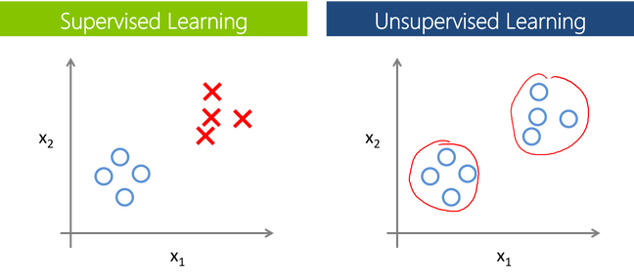
The machine learning model is nothing but a piece of code; which an engineer or data scientist models by training it with the data according to the need of the project and making the model learn through the data and allowing it to predict or give the solution that we want whenever we ask it to give. So, whenever we give our model the new data which we want it to predict, we will get the predicted value according to the model training, the trained model might or might not perform well on the test data that we want it to predict, due to various reasons, so before trying to train any model we need to make sure that the algorithm that is going to use is appropriate for the desired class that we want to predict and based on the data that we are using.

Slide 9
Supervised Learning
Supervised learning is a branch of machine learning where for each row in the dataset, each row is tagged with a particular label known as the target class. Supervised Learning is categorized into 2 other categories which are “Classification” and “Regression”.
Classification:
The classification problem is when the target variable is categorical (i.e., the output variable consists of classes such as —Class A or B or something else, there might be 2 classes or more than 2 classes.).
Regression:
While a Regression problem is when the target variable is continuous (i.e., the output is numeric), Regression problem can be easily termed as the problem where we have to forecast about the future or what we do not know right now, it can be anything (Example: House Price Prediction, Stock market trends)

Slide 10
Unsupervised
Unsupervised Learning is another branch of Machine Learning where we won’t be having any labels for each row of our data unlike supervised learning, so in this case, the model will try to segregate things based on the features and the data available. In simple terms it segregates the data in terms of clusters, the most important thing in unsupervised learning is the curse of finding the optimal k value (the number of clusters we would like to make).
Clustering:
Clustering is a process of learning to assign labels to examples by leveraging an unlabelled dataset, Because the dataset is completely unlabelled, deciding on whether the learned model is optimal is much more complicated than in supervised learning.

Slide 11
Overview of the Machine Learning Models
Machine Learning
Supervised
Unsupervised
Classification
Regression
Clustering
SVM
Linear Regression
DBSCAN
K-Nearest Neighbors
SVR, GPR
HDBSCAN
Naïve Bayes
Ensemble Methods
K-Means
Decision Tree, Random Forest
Decision Tree
Gaussian Mixture
Neural Networks
Neural Networks
Hierarchical

Slide 12
Training and Testing the model.
Before building any machine learning Project, training is the most important part, where we train our model using the data available and make the machine learn and understand the data, after which when the model has learned from the data, we provide the model with another dataset to evaluate how good our model is performing, if it is performing well, we then test the model using test data, where we get to know the final performance of our model, which can be measure using various metrics, such as Accuracy, recall, precision, and through classification report.
This whole process of building and deploying a model is done using 3 different datasets which are split using train_test_split(), which are ‘Training data’, ‘Validation data’, and ‘Testing data’.

Slide 13
Methodologies
Dataset’s descriptions:
event_type.csv: type of event related to the main dataset
log_feature.csv - features extracted from log files
resource_type.csv: resource type related to the main dataset
severity_type.csv: severity type of a warning message coming from the log
All the above CSV's except train.csv, test.csv, and sample_submission.csv, have been merged to make it has a single CSV file based on a specific primary key.

Slide 14
Algorithms
The Random Forest Classifier
Random Forest is a popular machine learning algorithm that belongs to the supervised learning technique. It is one of the widely used algorithms after Decision tree which perform well with any kind of dataset, be it classification or regression. It is based on the concept of ensemble learning, which is a process of combining multiple classifiers to solve a complex problem, and at the end, the results are either made an average of all the classifiers or mode of all the classifiers.
The greater number of trees in the forest leads to higher accuracy and prevents the problem of overfitting.
Note: This might not be applicable top every case that we use.

Slide 15
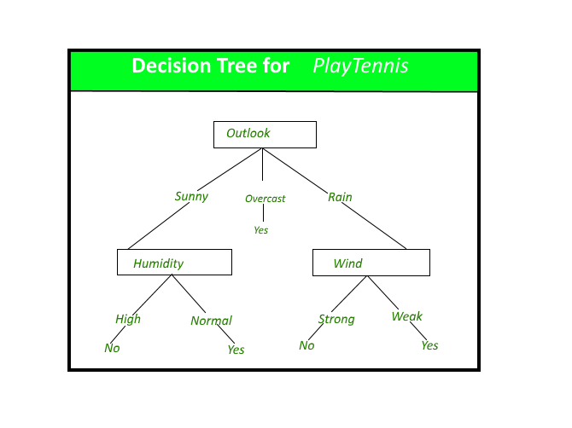
Decision Tree
A Decision tree, as the name suggests, creates a branch of nodes, where each internal node denotes a test on an attribute, each branch represents an outcome of the test, and the last nodes are termed as the leaf nodes meaning there cannot be any nodes attached to them, and each leaf node (terminal node) holds a class label. The decision tree is one of the most popular algorithms in machine learning, it can be sued for both classification and regression, similar to a random forest, there are some exceptions to decision tree also, in terms of data scaling and data transformation, since decision tree works like a flowchart in the form of branches doing data transformation and scaling might be optional.

Slide 16
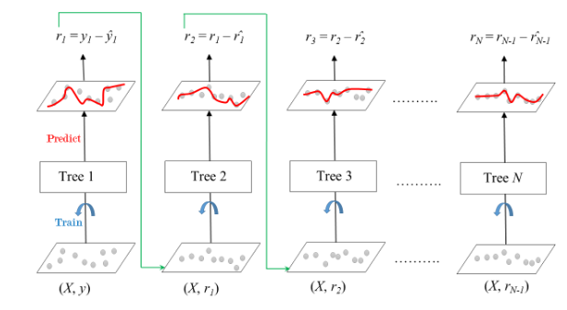
Gradient Boosting
Gradient boosting is a technique used in the development of predictive models. The method is most commonly used in regression and classification procedures. Prediction models are frequently depicted as decision trees for selecting the best prediction. Gradient boosting, like other boosting methods, presents model building in stages while allowing the generalization and optimization of differentiable loss functions.
The below diagram explains how gradient boosted trees are trained for regression problems.

Slide 17
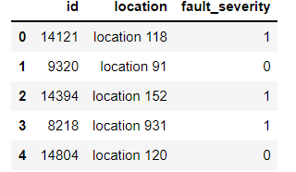
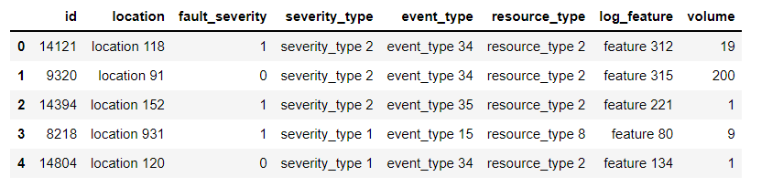
Data Overview

Slide 18
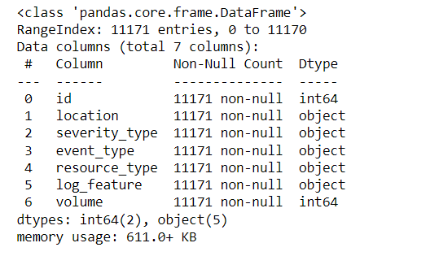
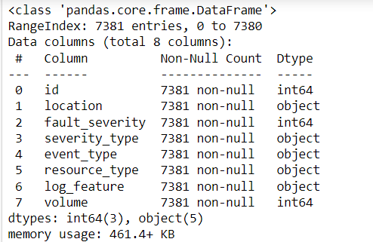

Slide 19
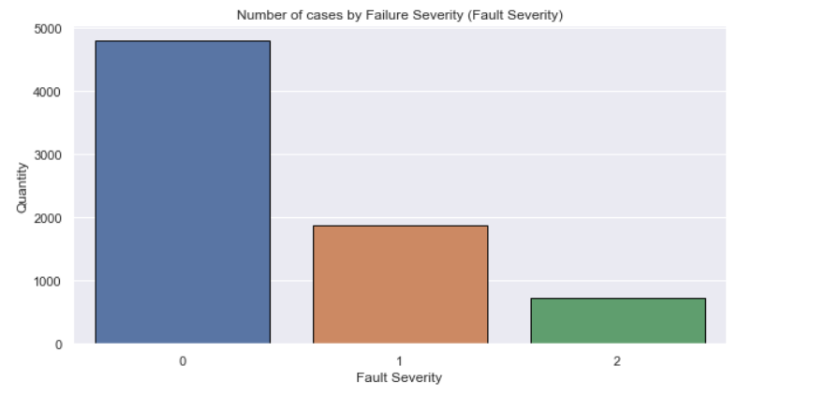
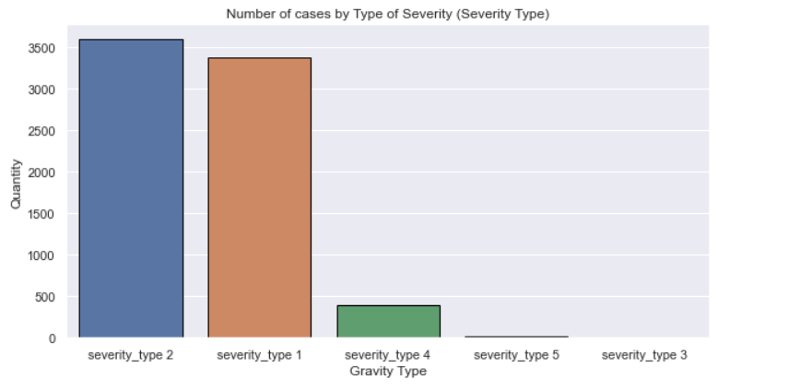
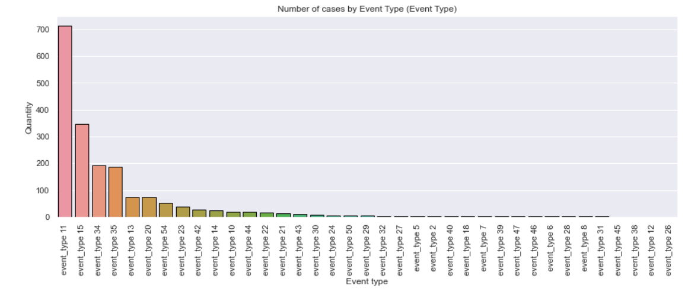
Visual Analysis

Slide 20
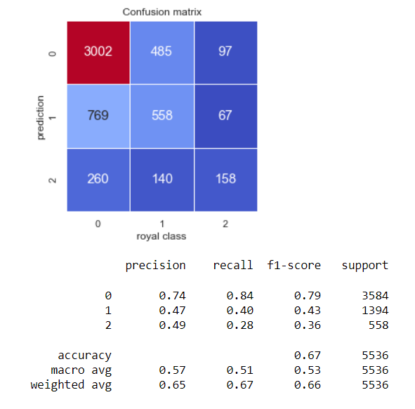
Algorithm Results
Random Forest Classifier

Slide 21
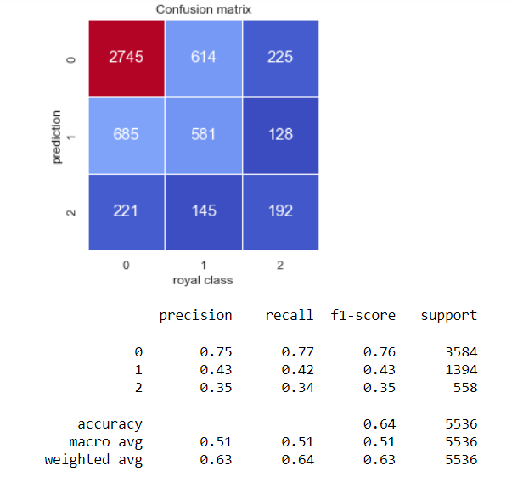
Decision Tree Classifier

Slide 22
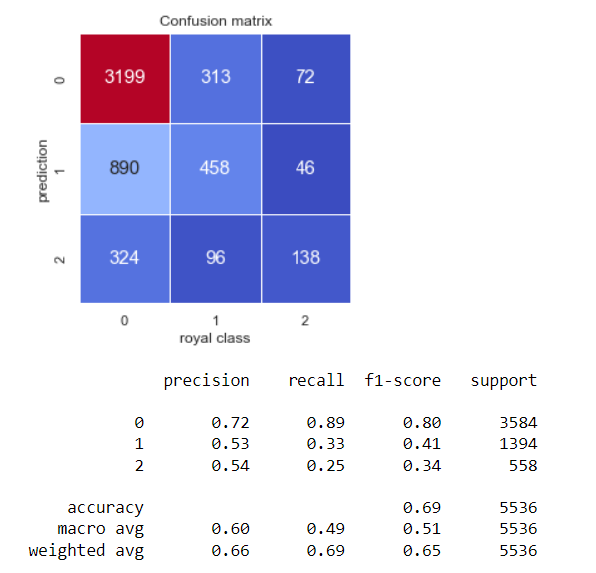
Gradient Boosting

Slide 23
Conclusion and Future Scope
As per the main objective of the project is to classify and identify the unknown network disruptions based on ML algorithms is being discussed throughout the project. Through this method, first, we have extracted the disrupted data information of the network traffic. Then the dataset is being sent for cleaning and data pre-processing to bring the data to the same scale which should be understandable to the machine and in the process of that we have merged all the files as one file to get a better understanding of the data to further help us classify and identify the fault severity. Finally, feature engineering is done to intelligently select the feature vectors to efficiently and accurately realize the classification and identification of unknown network disruption. This method made full use of the advantage of Machine Learning algorithms. Based on ensuring the classification and identification accuracy, it avoided the complex steps of manually extracting features and reduced the training time of the intelligent algorithm as well as the amount of labelled data required.
As part of the future scope, we hope to try out different algorithms to optimize the feature output process, increase the feature similarity of the same disruption data and widen the differences between different disruption data to improve the model's representation capability. We will also do further research on encrypted traffic, and try to use neural networks to find the potential characteristics of encrypted data.

Slide 24
References
Hong Z, Gong Q, Feng W, Li Y. Unknown Application Layer Protocol Identification Based on Adaptive Clustering. Computer Engineering and Applications. 2020, 56(05): 109-117.
Zhang F, Zhou H, Zhang J, Liu Y, Zhang C. A protocol classification algorithm based on improved AGNES. Computer Engineering and Science, 2017,39 (04): 796-803.
Li R, Xiao X, Ni S, et al. Byte segment neural network for network traffic classification[C]//2018 IEEE/ACM 26th International Symposium on Quality of Service (IWQoS). IEEE, 2018: 1-10.
Guo L. Research on Multi-Business Identification Technology Oriented High-Speed Network Management and Control. Doctor, The PLA Information Engineering University, Zhengzhou, Henan, China, 2012.
Wang W, Zhu M, Zeng X, et al. Malware traffic classification using convolutional neural network for representation learning[C]//2017 International Conference on Information Networking (ICOIN). IEEE, 2017: 712-717.
Feng W, Hong Z, Wu L, Fu M. Review of network protocol identification techniques. Computer Applications. 2019, 39: 3604-3614.

